Slide 1
LSB IMAGE STEGANOGRAPHY
What is LSB IMAGE STEGANOGRAPHY?
This project helps us to hide a message inside a image using LSB method.
LSB method means modification of lsb bit in the image to get the desired encoded message output at receiver side.

Slide 2
LSB IMAGE STEGANOGRAPHY
Why we need to use?
Hide secrete credentials data
Detect data forgery
Message passing

Slide 3
LSB IMAGE STEGANOGRAPHY
Where we use STEGANOGRAPHY?
Military
Intelligence agencies
Online elections
Internet banking

Slide 4
LSB IMAGE STEGANOGRAPHY
How we use STEGANOGRAPHY?
Physical
Prints and paints
Puzzels
Digital

Slide 5
LSB IMAGE STEGANOGRAPHY
Design :
Design part of the project it is devided into 2 parts
Encoding
Decoding
What we need?
We need image file i.e, .bmp file(it is uncompressed file). We need .txt file(it contains message)

Slide 6
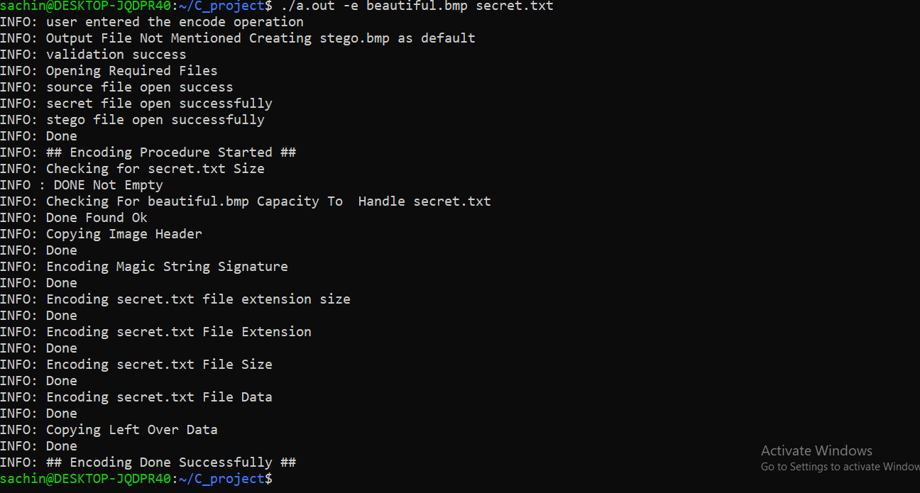
LSB IMAGE STEGANOGRAPHY
DESIGN : - Encoding

Slide 7
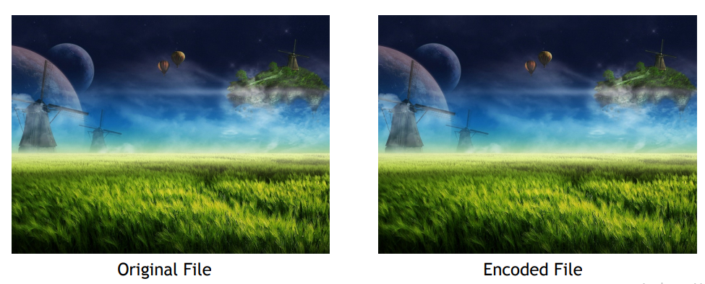
LSB IMAGE STEGANOGRAPHY
DESIGN : Encoding

Slide 8
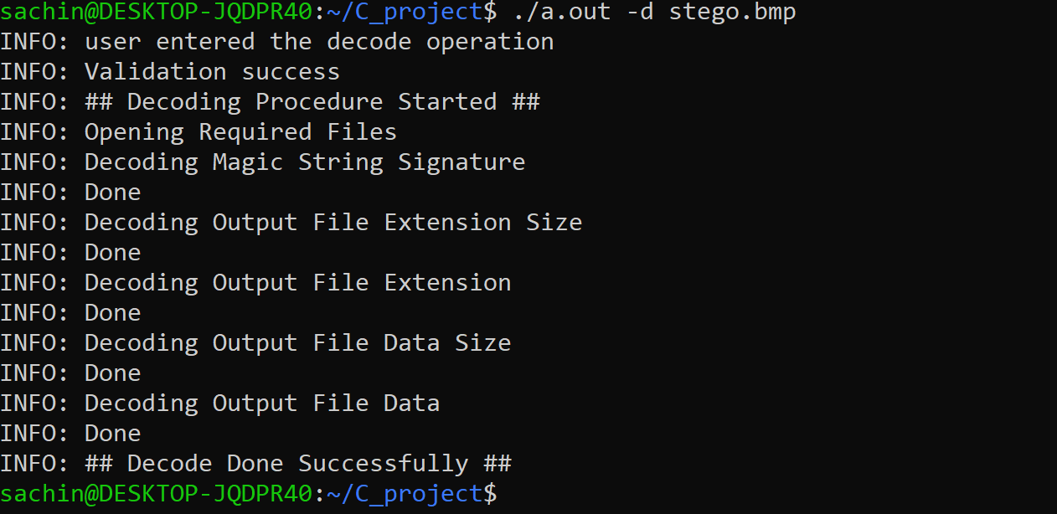
LSB IMAGE STEGANOGRAPHY
DESIGN : - Decoding

Slide 9

LSB IMAGE STEGANOGRAPHY
Error Handling:
We need to pass .bmp file text file and encode and decode option

Slide 10


